Slide 1


BIG DATA
PROJECT
UCAC-ICAM
GROUP 5
GROUP MEMBERS
SIKATI Samuel
ABDULLAHI Faris
TCHOUNGA Jordan
NGAMALEU Iris Carelle
EKABANA Kevin Floride
TCHATCHOUA Erwann-Axel
Academic supervisor
MR. HUMPREY Mbeng Ojong

Slide 2
TABLE OF CONTENT
INTRODUCTION
1
PLANIFICATION PROCESS
2
3
PROJECT PRESENTATION
4
DEMONSTRATION
5
CONCLUSION

Slide 3
01
INTRODUCTION
Notes:
following the call from the ADEM group to our Institute
for the realization of demonstrators and experiments of new
mobility solutions. A project to correct this mobility problem
has been awarded to us

Slide 4
01
CONTEXT
ADEME (Agency for the Environment and Energy Management) has launched a call for expressions of interest in promoting demonstrators and experiments with new mobility solutions for different territories. The Ucac-Icam institute structure has conducted studies on Intelligent Multimodal Mobility, which presents challenges in resource management and transport logistics.
3

Slide 5
OBJECTIVES
01
Realize an algorithm that will allow us to solve the problem
Find the most optimal path
Carry out a statistical study of our problem
4

Slide 6
01
PROBLEMATIC
How to most economically choose and implement an algorithm that will enable us optimize the logistic of transport in the urban zone?
5

Slide 7
CONSTRAINTS
01
Use of the neighbourhood algorithm
Project duration
Python Language
6

Slide 8

PLANIFICATION PROCESS
02
6 PCs
MATERIAL RESOURCES

Slide 9









02
PLANIFICATION PROCESS
SOFTWARE RESOURCES
8

Slide 10


02
PLANIFICATION PROCESS
HUMAN RESOURCES
PROJECT MANAGER
SIKATI Samuel
NGAMALEU Iris
EKABANA Floride
ABDULLAHI
Faris
TCHOUNGA JORDAN
TCHATCHOUA Erwann-Axel
9

Slide 11
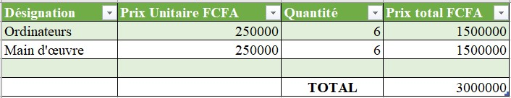
03
PLANIFICATION PROCESS
BUDGET
10

Slide 12
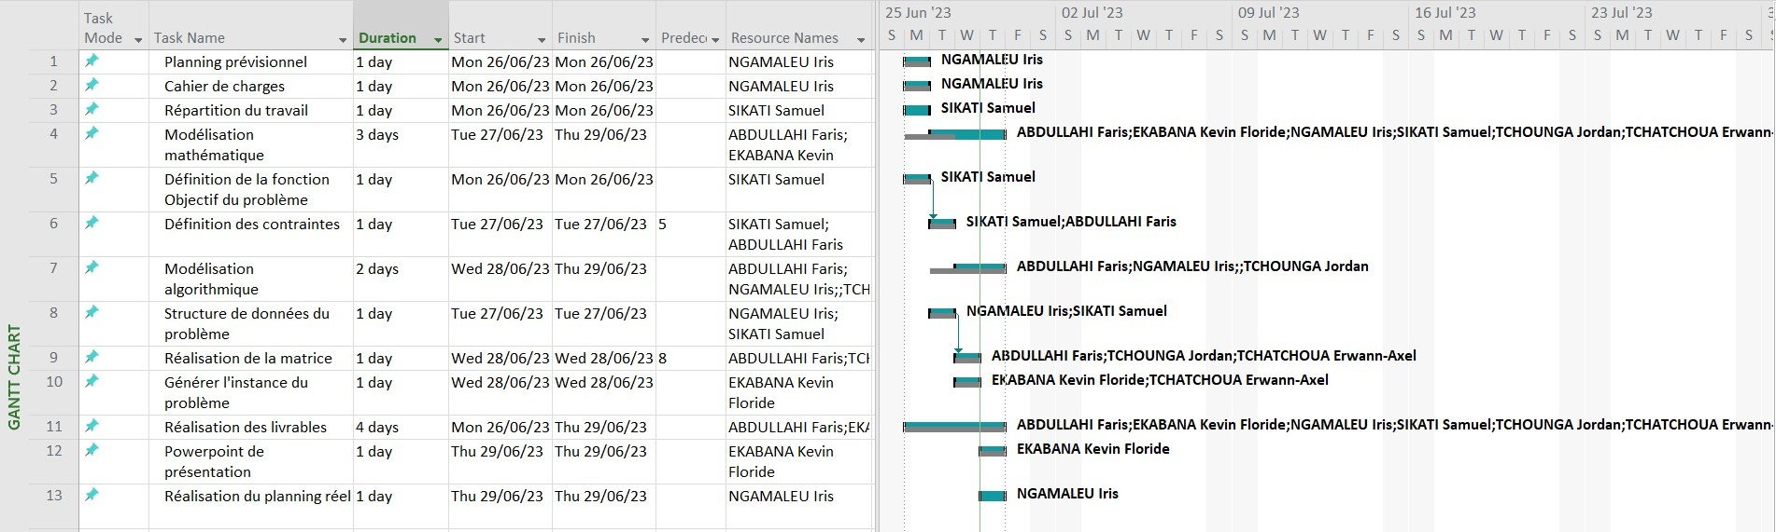
02
PLANIFICATION PROCESS
You can enter a subtitle here if you need it
11

Slide 13
PROJECT PRESENTATION
03
VRP COMPLEXITY
CVRP
Delivery
&
pick-up
Distance constraint
Time windows
VRPPD
CVRPTW
DCVRP
Notes:
VRP stands for Vehicle Routing Problem. It is a combinatorial optimization problem that involves determining the optimal set of routes for a fleet of vehicles to visit a given set of locations and satisfy certain constraints.

Slide 14
03
PROJECT PRESENTATION
WHY WE CHOOSE GENETIC ALGORITHM
Criteria | Genetic Algorithm | Ant Colony Optimization | Tabu Algorithm
Main Concept | Evolutionary computation | Swarm Intelligence | Local search-based algorithm
Problem Type | Global optimization | Combinatorial optimization | Local Optima
Search Strategy | Population-based, parallel | Iterative, constructive | Iterative, constructive
Exploration vs. Exploitation | Balanced | Emphasizes exploitation | Exploitation-oriented
13

Slide 15
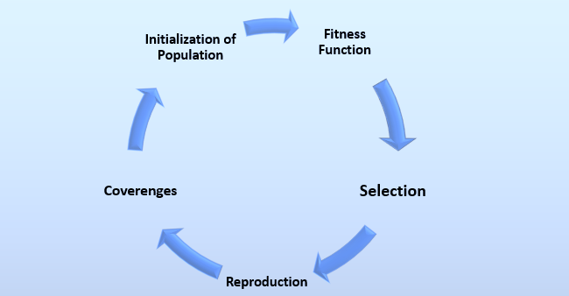
PLANIFICATION PROCESS
03
GENETIC ALGORITHM
Notes:
A genetic algorithm is a search and optimization technique inspired by the principles of natural selection and genetics. It is commonly used to solve problems where traditional algorithms may be difficult or ineffective. They are commonly used to solve optimization problems, such as finding the best solution in a complex search space.
It is an heuristic search method used for finding the optimal solutions based on evolution and natural selection
The basic idea behind a genetic algorithm is to create a population of candidate solutions, represented as individuals or chromosomes. Each chromosome contains a set of genes or parameters that define a specific solution to the problem at hand. The algorithm then applies a set of operations inspired by biological evolution, such as selection, crossover, and mutation, to iteratively improve the quality of the solutions over successive generations.

Slide 16
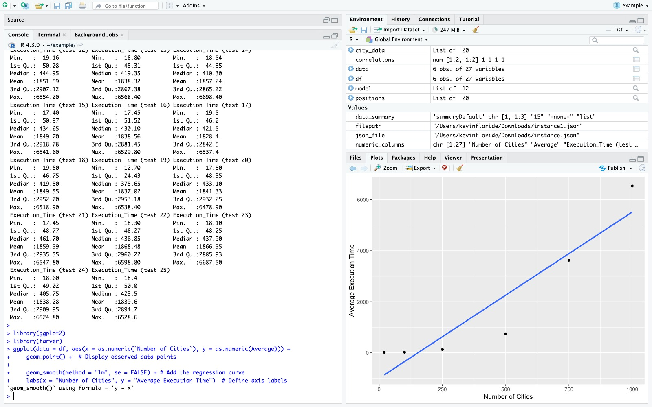
STATISTICAL STUDY

Slide 17
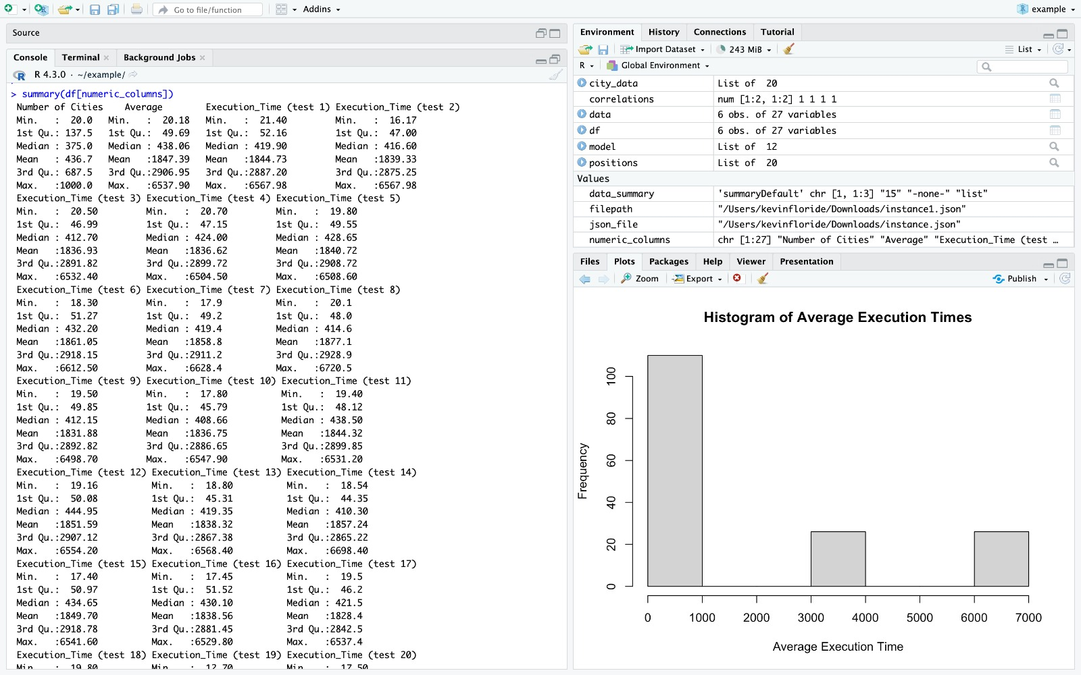
STATISTICAL STUDY

Slide 18
04
DEMONSTRATION
Notes:
following the call from the ADEM group to our Institute
for the realization of demonstrators and experiments of new
mobility solutions. A project to correct this mobility problem
has been awarded to us

Slide 19
05
PROBLEMS ENCOUNTERED
PROJECT TIME
UNDERSTANDING OF THE PROJECT
THE CHOICE OF THE ALGORITHM
THE REALIZATION GRAPH CREATION
Notes:
It is an heuristic search method used for finding the optimal solutions based on evolution and natural selection

Slide 20
05
PERSPECTIVES
IMPLEMENTATION OF PHASE 3 AND PHASE 4
ADDITION OF SOME CONSTRAINTS
IMPROVEMENT OF THE DATA COLLECTION AND STATISTICAL ANALYSIS FOR THE DIFFERENT
Notes:
It is an heuristic search method used for finding the optimal solutions based on evolution and natural selection

Slide 21
04
CONCLUSION
Notes:
following the call from the ADEM group to our Institute
for the realization of demonstrators and experiments of new
mobility solutions. A project to correct this mobility problem
has been awarded to us

Slide 22
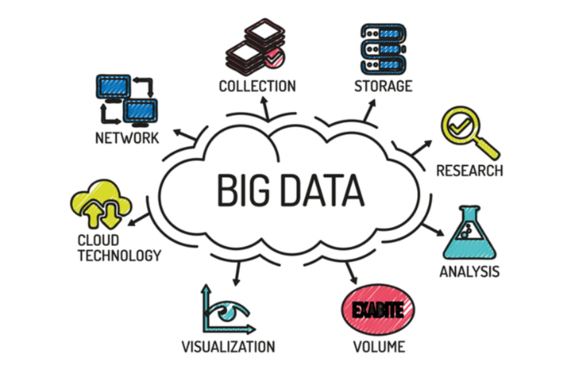
THANKS FOR YOUR ATTENTION !!
18

